Slide 1
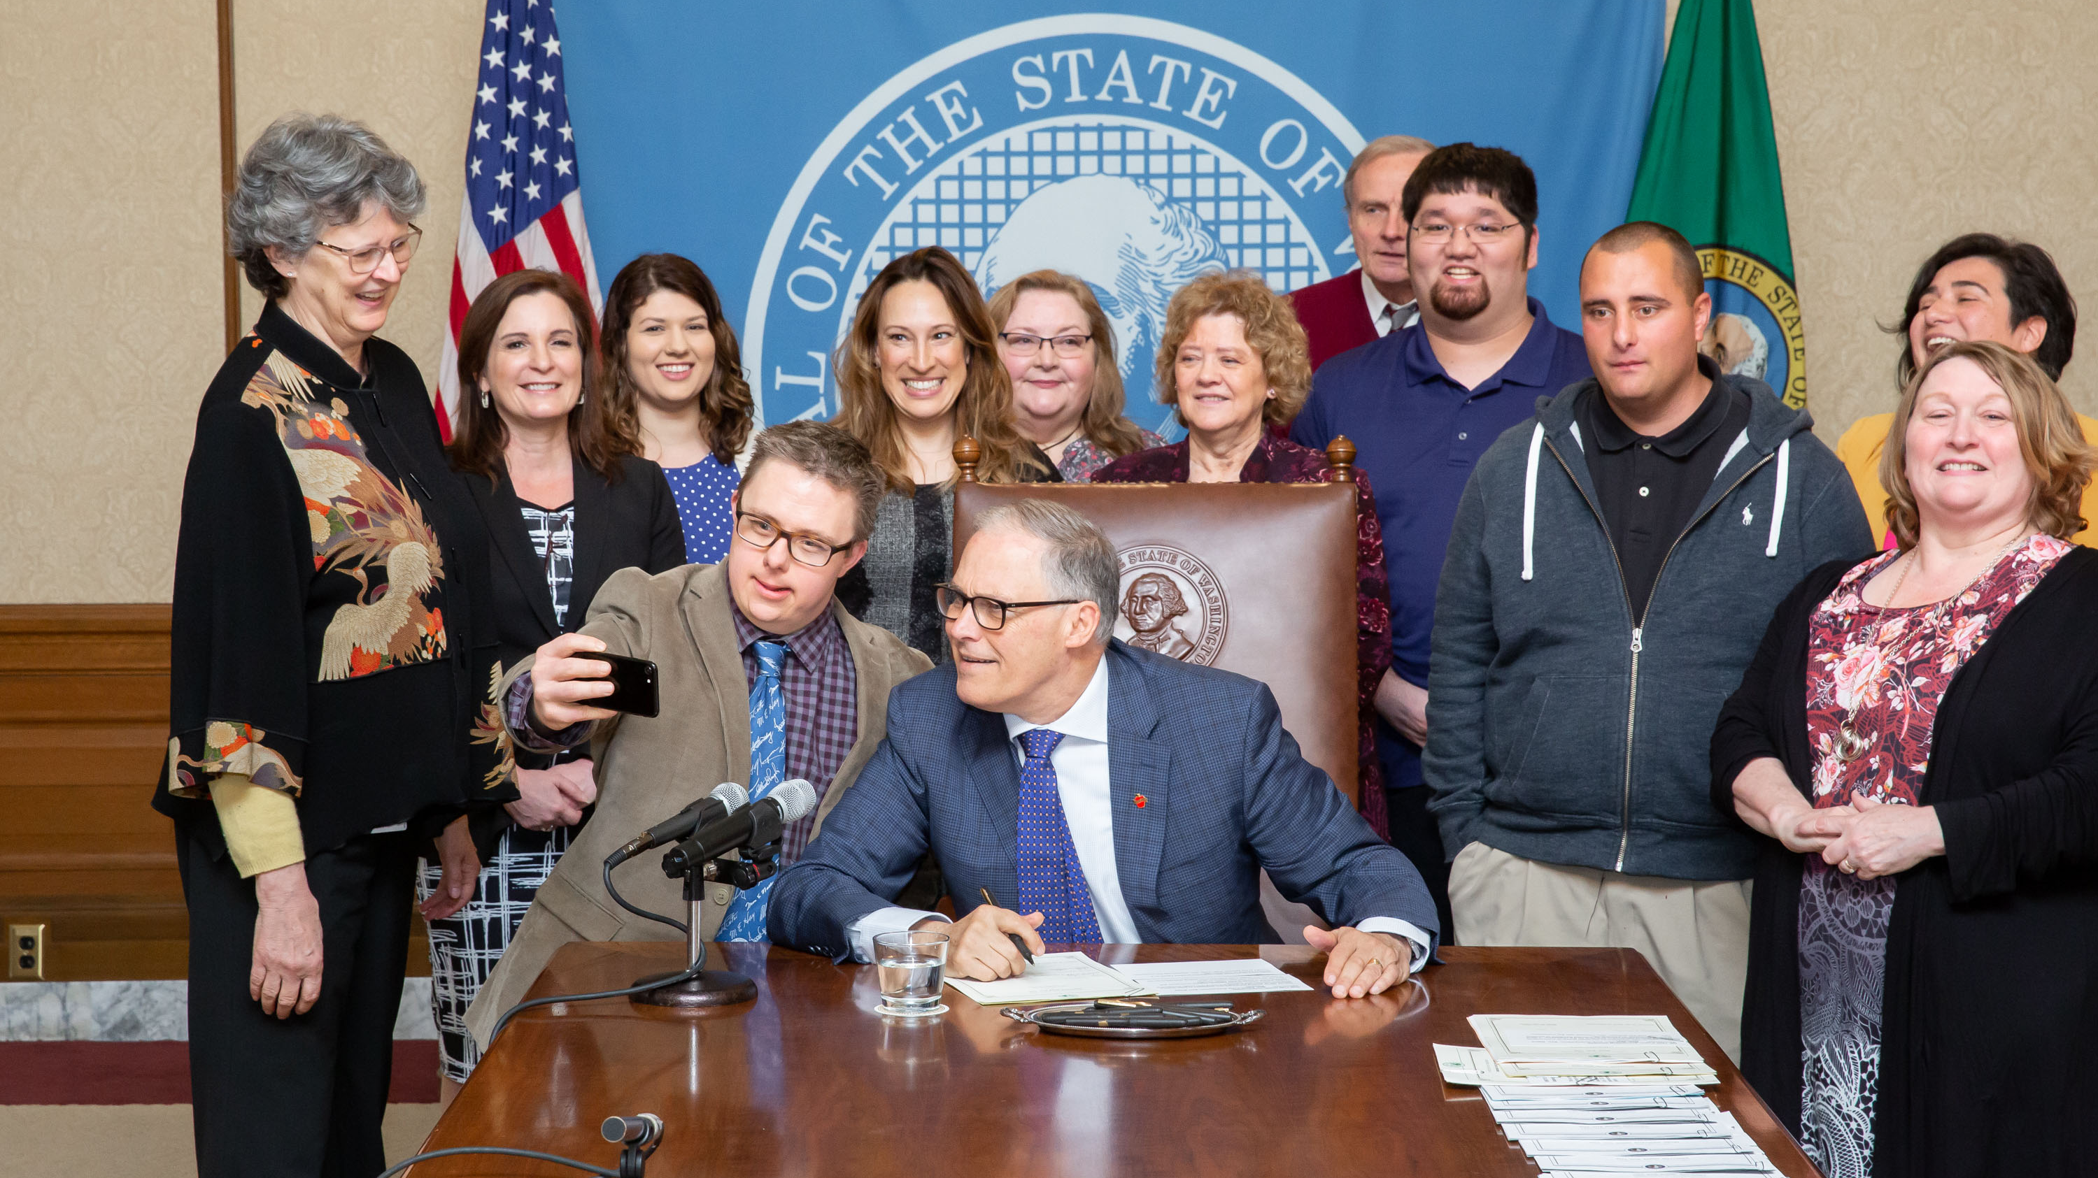

Legislative basics
February 21, 2023
Ramona Hattendorf
Director of Advocacy,
The Arc of King County
Notes:
At The Arc of King County, we protect and promote the rights of people with developmental disabilities and actively support participation in community across the lifespan.
The advocacy team helps people improve services and supports. We work on access to health care and long-term supports, including supported living and employment; inclusive early learning and K-12 education; housing and homelessness; and civil rights advancements and protections.

Slide 2
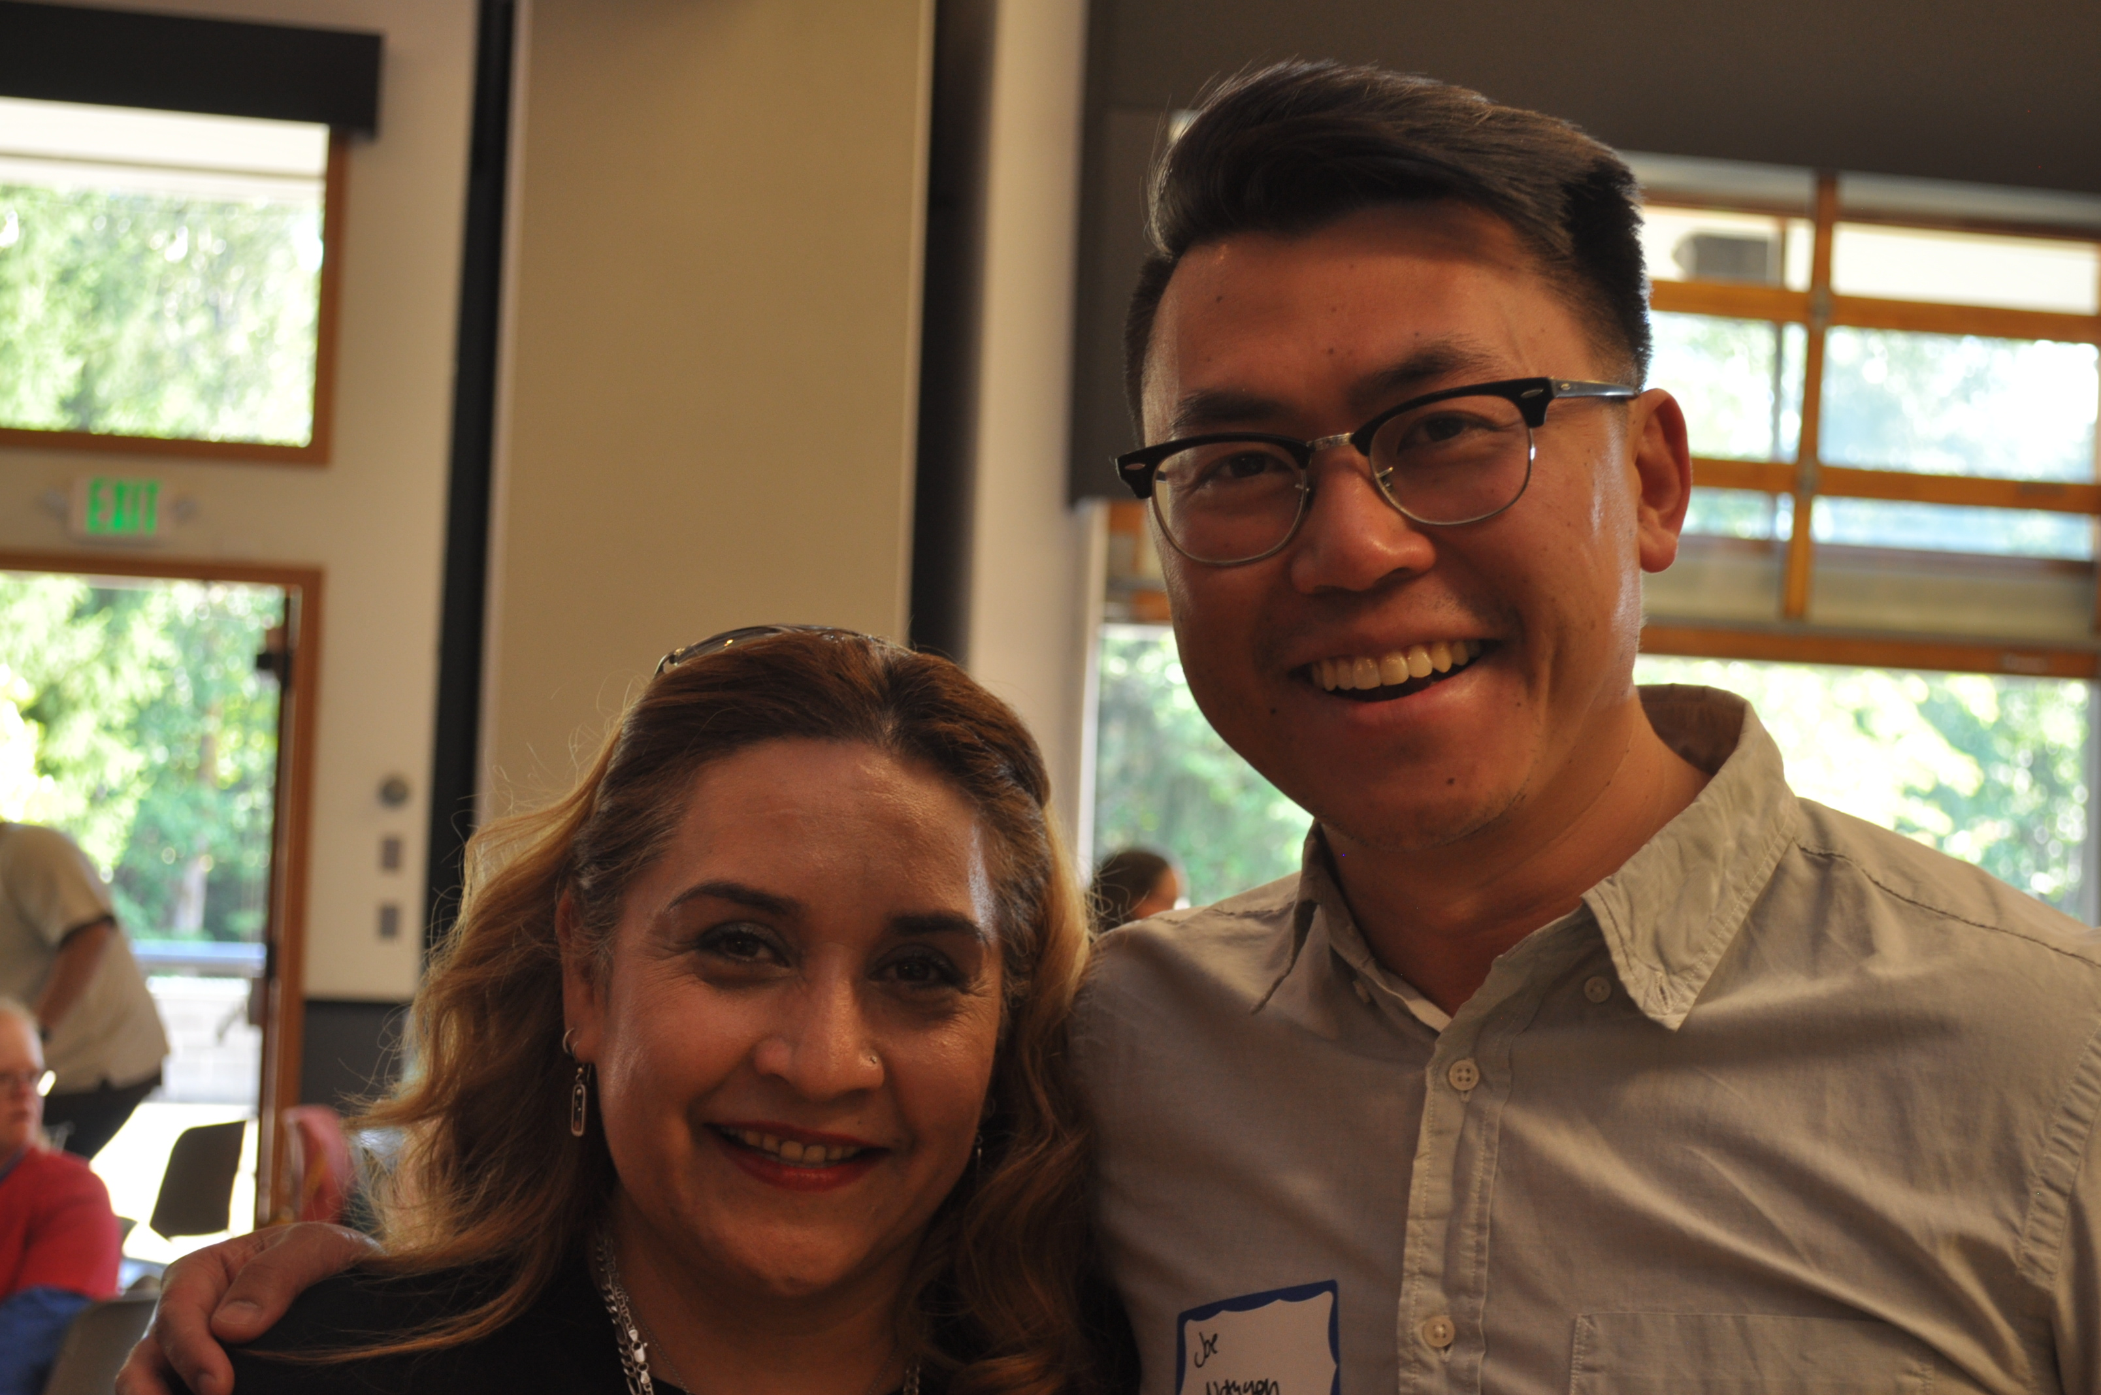
Who we are …
The Arc of King County promotes and protects
the rights of people with intellectual and developmental disabilities (IDD) so we can all live, learn, work and play in the community.
We believe everyone should be able
to live the life they choose.
We offer information and family support,
systems navigation, education & civic engagement support. We also run a supported living program for adults with IDD.
We help on any topic. The most common
are special education, housing, Medicaid
long-term supports, and social security.
https://arcofkingcounty.org/

Slide 3

What is
public policy?
Rules we agree to
live by as a society.
Policies that govern
the public .
But ALSO ​…
Rules that the PUBLIC has an opportunity to influence
Notes:
Public policy exists because people want it; it improves because people choose to participate in the process.

Slide 4

How do you influence public policy?
1. Know who to contact
2. When to contact them
3. What to say

Slide 5
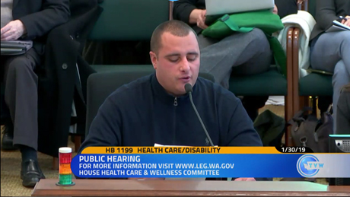
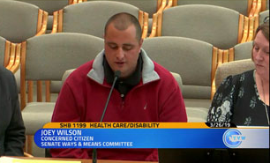
Notes:
Do you remember our first photo slide? It turned out, Joey had power. He heard about an issue that would make a big difference in his life. He pursued it. He influenced and help create public policy.

Slide 6
Legislative: sets policy & votes on the budget
Executive: carries out laws; runs government
Courts: interpret the laws
Notes:
The big 3 public policy power brokers are your government branches:
Legislative – passes laws and budgets. Also called Congress, the state legislature, city council
Executive – Also called president, governor, mayor. This person oversees government agencies and carries out the policies set by the legislature. We elect the executive … BUT … the executive appoints people who run agencies and commissions. Those non-elected people also have power – they decide the details of how laws will be carried out. This is called “rule making”
Courts – Interpret the law. Sometimes justices are appointed (US Supreme Court) sometimes they are elected (WA State Supreme Court). If you sued to protect your rights, you would be engaging in legal advocacy.

Slide 7
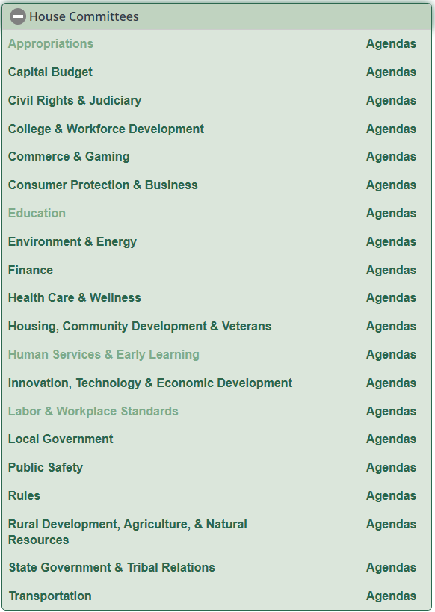
Legislative: passes laws and votes on the budget
Notes:
The legislature is organized by committee. Non-partisan staff support these committees. They do research, explain legalities.
Chairs of these committees decide what bills will be heard, when they will be heard, and whether they will be voted on.

Slide 8
Bare basics – Washington State Legislature
Meets every year, with alternating “long” and “short” sessions.
Pass a 2-year budget in the long session.
Update that budget in the short session
Consider policy changes in both, but only big-ticket items in the long session
A bill that only makes it part way in year 1 can continue in year 2
Federal = Congress.
Pass laws that affect the nation; budget funds national agencies
State = State legislature.
Pass laws that affect just Washington state. State laws must align with federal law
Local = Counties, cities, school boards. Laws and policies that affect local area. Must align with state and federal law
(FYI – Collective bargaining agreements are NOT law; they are contracts. Must align with federal and state law and applicable local law)

Slide 9

Policy
Fiscal
Rules
Floor
Every step can require messaging
Chamber 1
Policy
Fiscal
Rules
Floor
Chamber 2
Then to governor … who can sign it, veto it, or veto sections of it.
Notes:
This is what is going on in the background:
Bills get read and referred to a committee. The chair of that committee may or may not hold a hearing.
If there is a hearing, it may or may not be referred out of committee. Most bills get amended, and you may or may not like the changes.
Will the budget committee agree it is worth the investment?
Does it have enough consensus to clear Rules? If the clock is ticking, will leadership make sure it is called up for a vote?
Is there any chance of a veto?
Contacting your legislators is important … but it is also important to contact others involved in the process

Slide 10
And they’re off … bill making
1. Bill is “read” and referred to committee
2. Chair decides if a bill will be heard. Not all
will be heard
    (Public comment at hearings)
3. Chair decides whether to call a vote. Not all
bills will be voted out of committee
Notes:
If you want your feedback part of the public record, testify at a hearing.
Otherwise, you can use the legislative bill comment function; or … send an email, call the office, connect on social media. Make an in-person appointment.
Other ways: Attend a town hall

Slide 11
And they’re off … bill making
4. Committee members offer and vote on
amendments in executive session
    (No public comment)
5. If passes, the bill goes to Rules committee.
Someone from Rules needs to “pull” the bill
for it to go to the full chamber for
consideration. Not all get pulled

Slide 12
And they’re off … bill making
6. Goes to “floor” (full chamber). Leadership
decides when/ whether to vote. Not all will
be voted on
7. MORE amendments, including “strikers”
8. Passes to the other chamber!
Process repeats
Notes:
Organizations use professional lobbyists not so much because they are persuasive … but because they have the time to track fast-moving bills and pinpoint who needs to be won over. They are strategists behind the scenes. Typically, they organize “real people” to testify

Slide 13
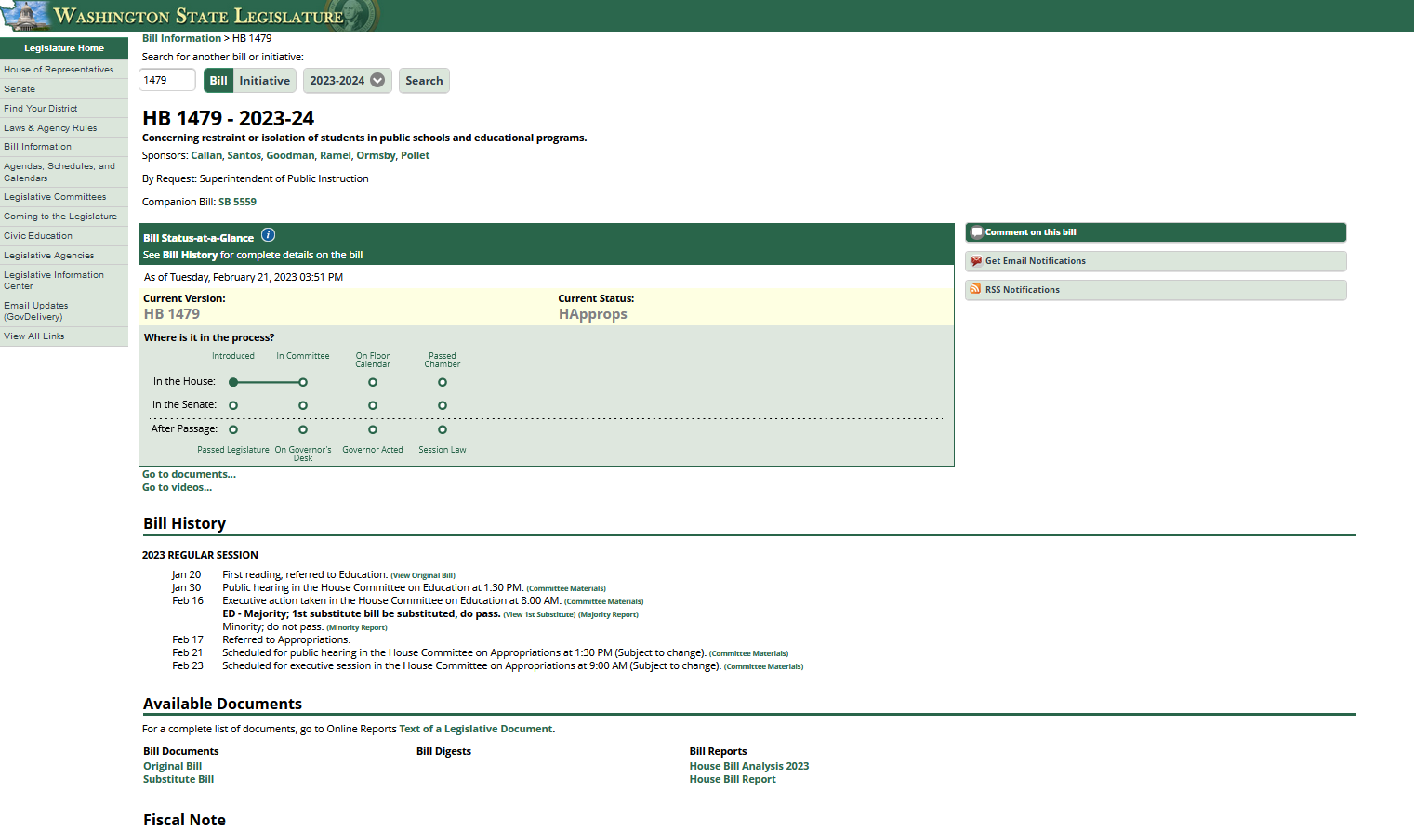

Slide 14
Why advocate?
So public policies & budgets
are responsive to the people
they support
Also, because ….
Legislators are not experts on all things – but they VOTE on all things. They rely on constituents and advocates they trust to educate them
We have a representative democracy. We elect people to vote on our behalf. Elected leaders don’t know what we want/need if we don’t tell them
Continuous improvement. Advocates let government know what is working (or not)

Slide 15
2 times/ways to advocate
To committee
considering the bill
To YOUR elected
representatives
They are weighing
1 – Should I recommend this bill to my colleagues?
2 – Is it OK as is, or should we make changes?
Advocates need to say what they like and do not about the bill. Advocates also update each other on changes
They are weighing
1 – How will this affect my constituents
2 – How will this affect the budget?
In addition to voting on a bill, they can speak to the bill in caucus. They can let leadership know it is a priority (or not)

Slide 16
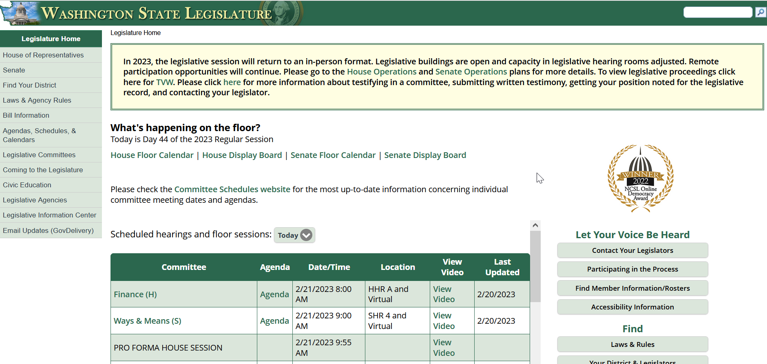
https://leg.wa.gov

Slide 17
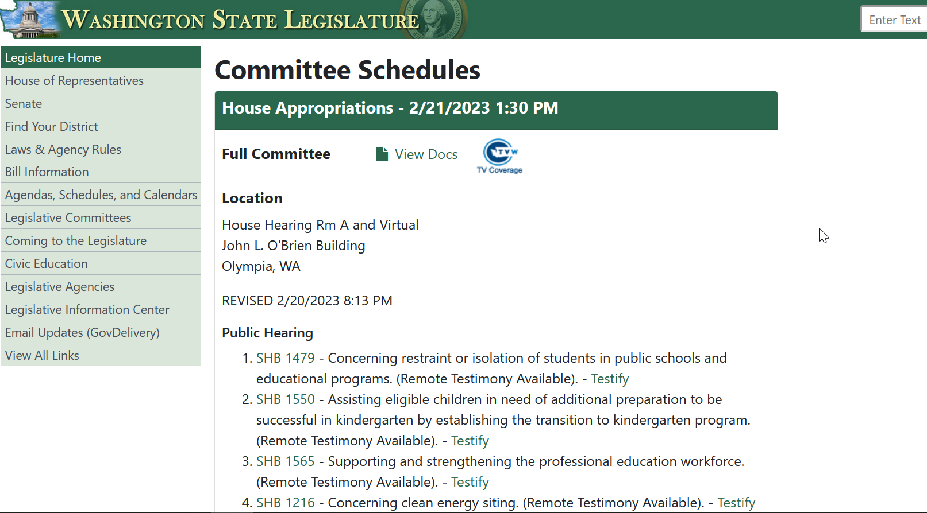
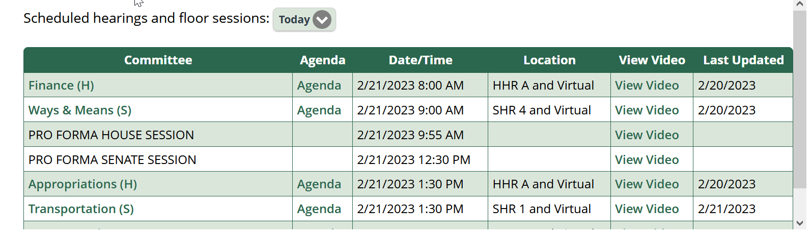

Slide 18
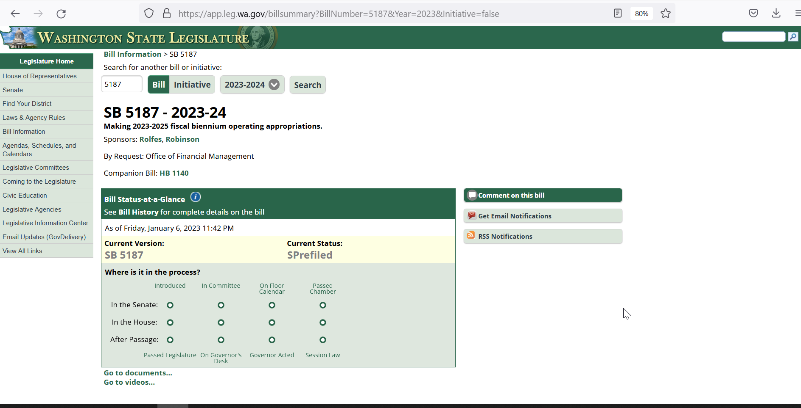
Notes:
The bill needs allies along the process; you need to help build support.
Once I have a bill # and a bill page, I will use the “comment on this bill” to ask for my legislators’ support.
When there is a hearing, I will sign in, and I will either testify live, or send in written testimony. Or both.

Slide 19
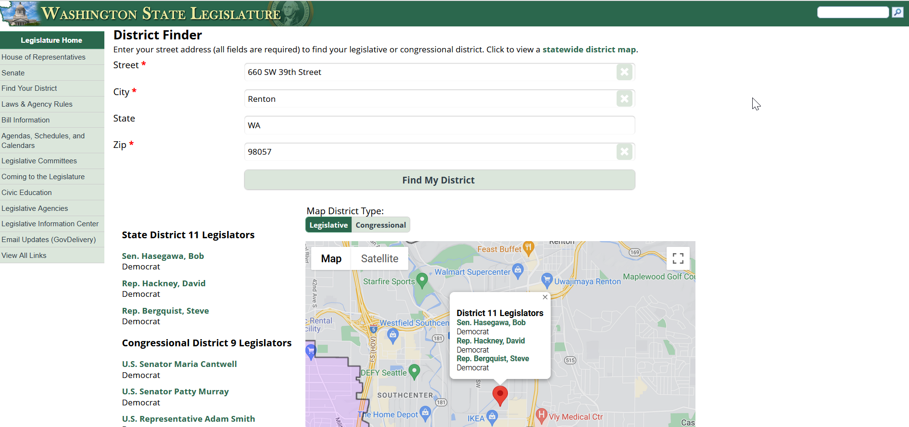
https://app.leg.wa.gov/DistrictFinder/

Slide 20
Advocacy @ The Arc of King County
We protect and promote the rights of people with intellectual and developmental disabilities and work to build inclusive communities
Positions & Priorities
https://thearc.org/position-statements/
https://arcwa.org/wp-content/uploads/sites/35/2022/09/TheArc2023-Public-Policy-Agenda.pdf
Disability supports & human services
Education
Health
Housing
And more!

Slide 21
Education bills we are tracking
HB 1109 - Providing funding for school districts for special education (summertime evaluations)
HB 1239 - Establishing a simple and uniform system for complaints related to, and instituting a code of educator ethics for, conduct within or involving public elementary and secondary schools.
HB 1305 - Improving access to and provision of a free and appropriate public education (includes changing “burden of proof”)
HB 1479 - Concerning restraint or isolation of students in public schools and educational programs.
HB 1550 - Assisting eligible children in need of additional preparation to be successful in kindergarten by establishing the transition to kindergarten program.
SHB 1565 - Supporting and strengthening the professional education workforce.
SB 5311 - Concerning the special education funding formula. (increases multiplier)
HB 1436 - Funding special education. (Raises cap; increases multiplier)
SB 5315 – Concerning nonpublic agencies operating special education programs for students with disabilities.
https://bit.ly/1479EasyRead

Slide 22
Other big ones
Cut off calendar
Feb 17 –policy/origin
Feb 24 –fiscal/origin
March 8 – chamber/origin
March 29 –policy/opposite
April 4 – Fiscal/opposite
April 12 – chamber/opposite
April 23 – budgets and “necessarily to implement the budget”
HB 1580 – Creating a system
to support children in crisis
HB 1628 – Real Estate Excise
Tax for affordable housing
(with IDD fund)
HB 1451 – Nothing About Us Without Us
HB 1694 – Homecare workforce shortage

Slide 23
Subscribe!
Sharing, resources and information news
Engage, legislative and policy news and opportunities for civic engagement
https://signup.e2ma.net/signup/1894973/1898164/
Links
Web site: https://leg.wa.gov/
District finder: https://app.leg.wa.gov/DistrictFinder/
Bill information: https://app.leg.wa.gov/billinfo/
Cut off calendar: https://leg.wa.gov/LIC/Documents/EducationAndInformation/2023%20Draft%20Cutoff%20Calendar.pdf
Classes: https://leg.wa.gov/LIC/Pages/classes.aspx

Slide 24
Who to contact

Slide 25

Your legislators
Legislators with influence
  Sit on committees that will consider the bill
  Have leadership positions
  Are held in high regard by other legislators
The governor
Allies who can help build the cause
Notes:
After the funding forum Thursday, I did 2 things:
1 – reached out to my legislator who was in attendance
2 - reached out to all the legislators who attended
I wanted MY legislator to know I was there, I heard what she had to say, I really care about this issue
I wanted other legislators to know I had a constituency and WE really cared that they were there. Also, I had additional information to share about WHY we really care

Slide 26
When to contact

Slide 27


Timing is important
1. A bill is read and referred to committee (1st reading)
2. Committees consider, debate, and amend bills
3. If the bill makes it out committee, it gets a 2nd reading, when the whole chamber considers, debates, and amends
4. They then vote on final, amended version (3rd reading)

Slide 28
How often?

Slide 29
When should you contact your legislators?
1 - Connect very early on in the session
  This is a general communication:
  This is my situation/hope/goal/dream.
  I hope I can count on you this session
2 - Comment when a bill is heard/dropped
  This is a more focused conversation:
  I support this bill. It addresses my situation; I hope I can count on your support as it makes its way through the chamber
3 - Remind them about the bill as it nears a vote or key decision
  This is a more focused conversation: The bill I care so much about made it this far, I hope I can count on your support to get it to the finish line. Please let me know if you need additional information.
4 – Thank them
  Also thank allies as the bill moves through the process (sponsors and cosponsors; people who pass it out of committee; if you know, to people who got it pulled to the floor …)
Notes:
After the funding forum Thursday, I did 2 things:
1 – reached out to my legislator who was in attendance
2 - reached out to all the legislators who attended
I wanted MY legislator to know I was there, I heard what she had to say, I really care about this issue
I wanted other legislators to know I had a constituency and WE really cared that they were there. Also, I had additional information to share about WHY we really care

Slide 30
Know what you want to say

Slide 31
Craft a
clear
message
1. Who are you?
2. What is your issue?
3. Why do you care?
4. Why should they care?
5. What should they to do?

Slide 32
Good afternoon chair and committee members,
<WHO> I am Ramona Hattendorf with The Arc of King County, speaking in support of HB 1980. The Arc protects and promotes the rights of people with intellectual and developmental disabilities and helps build inclusive communities. We serve the 36,000 people with IDD across King County.
<ISSUE> Our state’s insistence on either/or when it comes to day services has isolated people and undermined their well-being. We require people to choose employment support OR community inclusion when often they need both.
<WHY I CARE> DDA services are habilitative. This means helping people learn, keep, or maintain skills that are not typically developing. People with IDD need ongoing skill support throughout their lives.
Day services help people maintain essential skills needed to support well-being and interact with their community.
<WHY AUDIENCE SHOULD CARE> Employment support is a great day service. But lots of people need a “yes, AND …” approach.
Maybe they have severe anxiety and could benefit from community inclusion during a job search. Maybe they have a job, but it is only a few hours a week and they need additional skill maintenance outside it. Or maybe they lost their job, have no immediate prospects, but need support looking for a job while also still engaging in the community.
This bill is a “yes, AND …” approach so people get the support mix they need for their situation. Same hours of support; flexibility for their situation.
<ACTION> Please support and move this bill this session. Thank you.

Slide 33
60-second version
Good afternoon chair and committee members
<WHO> I am Ramona Hattendorf with The Arc of King County, speaking in support of HB 1980 and advocating for 36,000 people with IDD in King County.
<ISSUE> Our state’s insistence on either/or when it comes to day services has isolated people and undermined their well-being.
<Why I care> DDA services are habilitative. This means helping people learn, keep, or maintain skills that are not typically developing.
Day services help people maintain essential life skills needed to support well-being and interact with their community.
<Why audience should care> Employment support is a great day service. But lots of people need a “yes, AND …” approach.
Maybe they have severe anxiety and could benefit from community inclusion during a job search. Maybe they have a job, but it is only a few hours a week, and need additional skill maintenance outside it.
<Action> This bill is a “yes, AND …” approach so people get the support mix they need for their situation. Please pass out of committee this session. Thank you.

